Slide 1
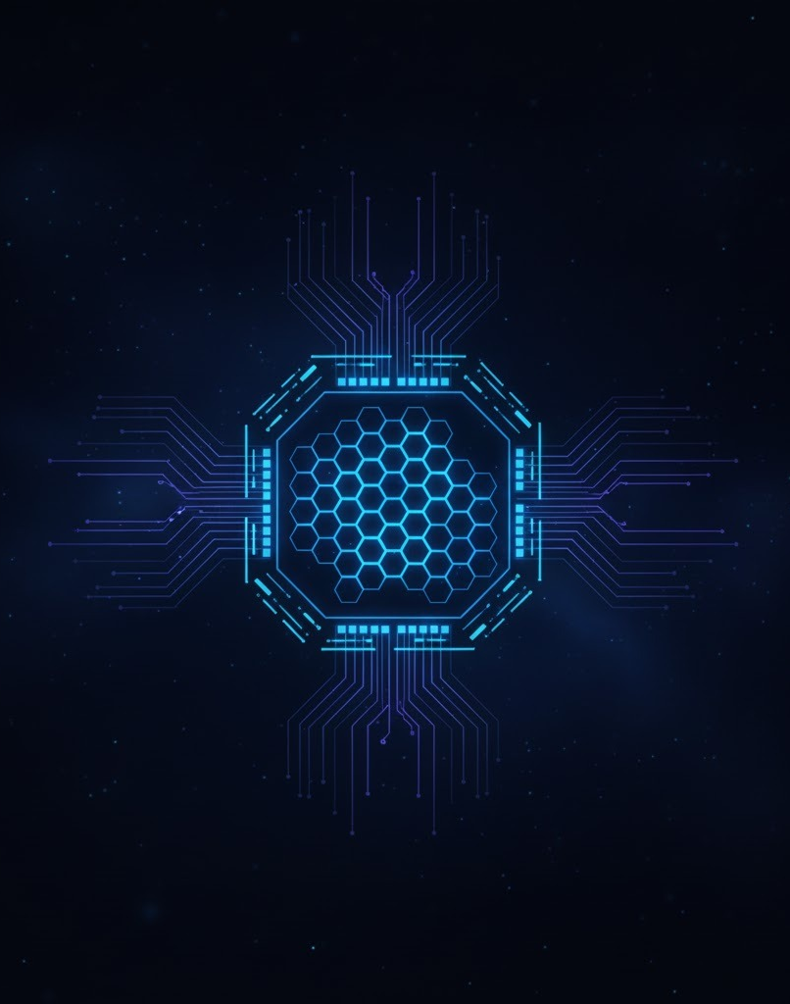

Solar-Blind UV Imaging Using Ga₂O₃ Photodetector Array
Capstone Project: CP302
Supervisor: Prof. Mukesh Kumar
Presented By: Khushi Tapariya 2022EPB1235

Slide 2
Project Objectives
01
02
03
Design Solar-Blind UV
Imaging System
Create Readout Circuit
Reconstruct Illumination
Pattern
Develop interconnected n×n Ga₂O₃
photodetector array
Convert photocurrent variations
into electronic signals
Generate spatial UV image from
active detector responses
2

Slide 3
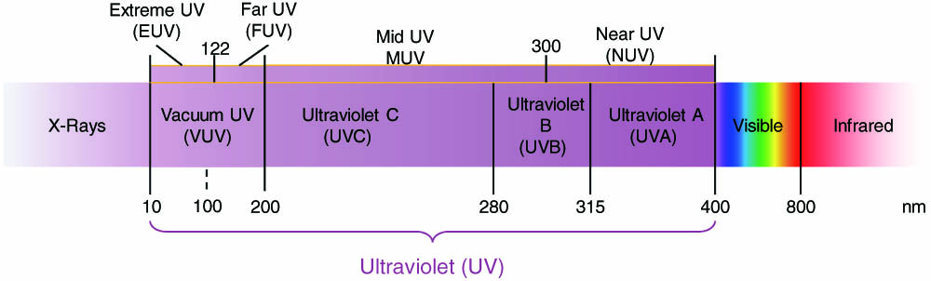
The Solar-Blind Detection Challenge
The solar-blind region lies in the 200–280 nm deep-UV band, which is completely absorbed by the ozone layer and never reaches the Earth’s surface.
Because sunlight does not exist in this wavelength range, any detected signal is guaranteed to be non-solar and man-made.
To achieve true solar-blind sensing, detectors must:
Be highly responsive only to deep-UV photons
Block all visible and near-UV light to prevent false signals
Maintain low dark current, low noise, and fast response time
Exhibit high durability and long-term environmental stability
Fig: 1 UV spectral region and its subdivisions
3
Ref: Researching.cn

Slide 4


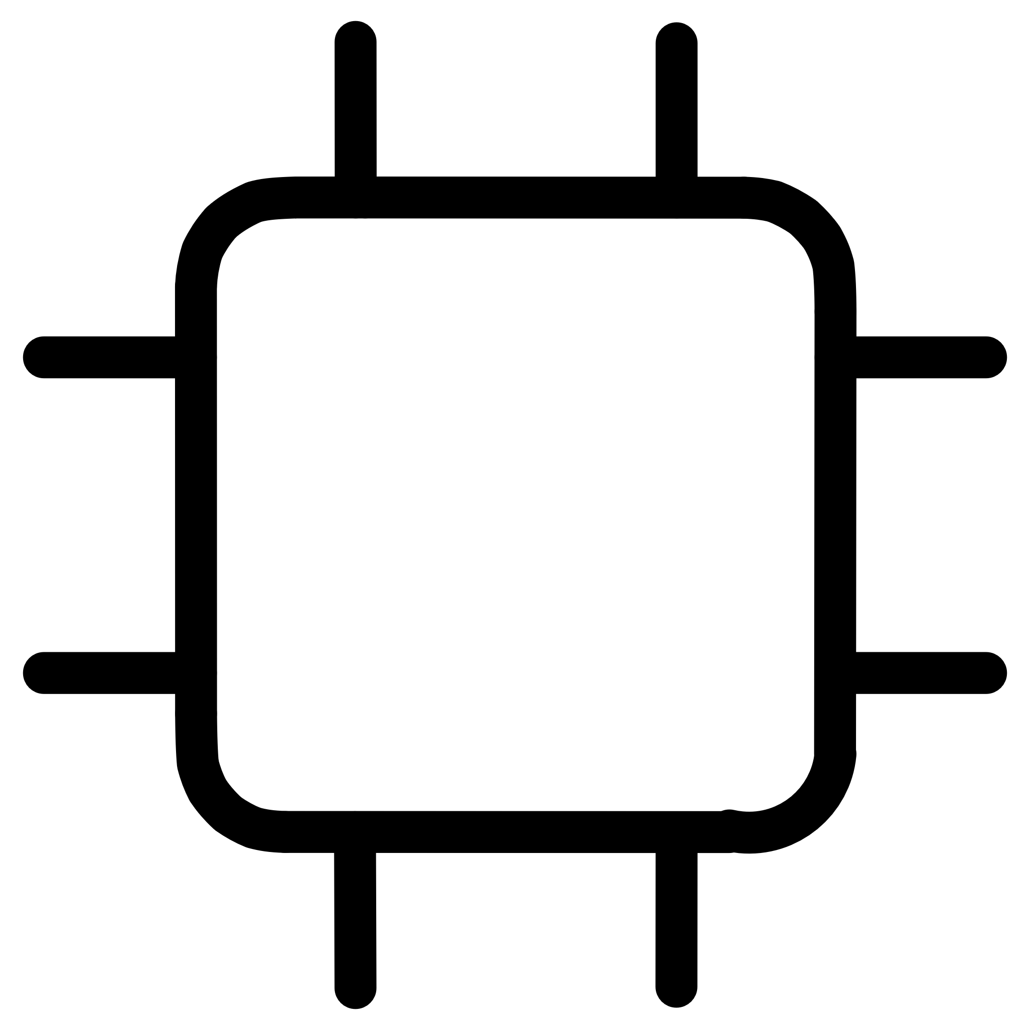
Why Gallium Oxide?
Ultra-Wide Bandgap
Exceptional Stability
Scalable Fabrication
~4.8–4.9 eV bandgap naturally restricts photoresponse to deep-UV wavelengths. Produces very Low Dark Current.
High thermal stability (melting point ~1900°C) and chemical robustness.
reliable in harsh outdoor environments.
Forms high-quality thin films on inexpensive substrates for large-area arrays, industry-friendly fabrication.
4

Slide 5
Ga₂O₃ Material Properties
Property
Description
Crystal structure
Monoclinic (β-phase)
Bandgap energy
~4.8–4.9 eV
Absorption edge
~260–280 nm
Electron mobility
100–150 cm²/V·s
Breakdown field
~8 MV/cm (higher than Si or GaN)
Thermal stability
Melting point ~1900°C
These properties enable low dark current, high detectivity and excellent signal-to-noise ratio for solar-blind detection.
5

Slide 6
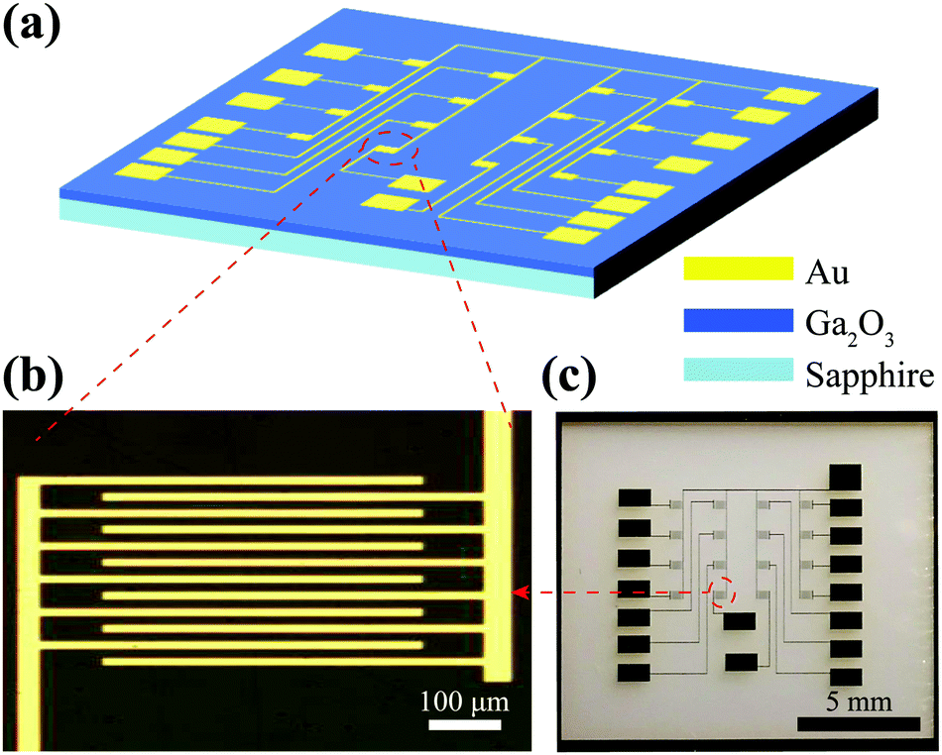
Imaging Through Photodetector Arrays
Spatial Light Conversion
A photodetector array (nxn) consists of n^2 detectors arranged in a 2-D grid, where each detector acts as a single pixel.
Each pixel converts incoming light intensity into an electrical signal, giving spatial information.
The signals from all pixels are digitized and combined to reconstruct the full image.
Image Reconstruction
Fig: 2 (a) Schematic of the photodetector array comprising 16 Ga2O3 photodetector cells. (b) Microscope image of a single photodetector cell. (c) Photograph of the photodetector array.
Ref: pubs.rsc.org
6

Slide 7
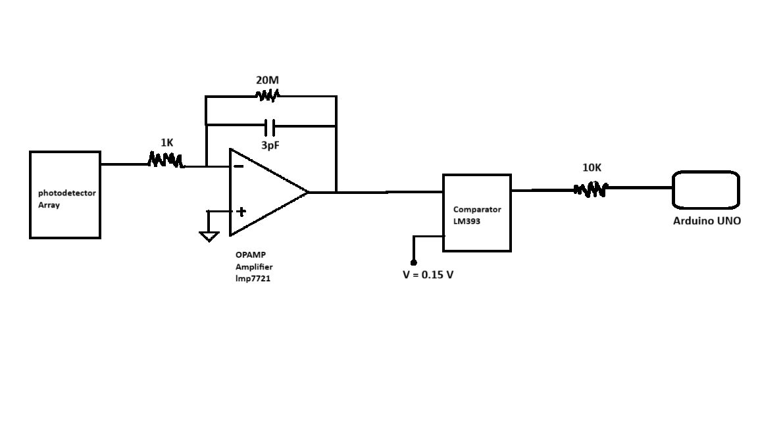
Circuit Design Architecture
Fig: 3 The readout circuit for Solar blind photodetector imaging
7

Slide 8
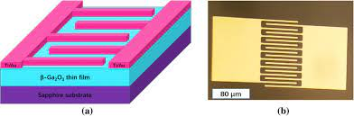
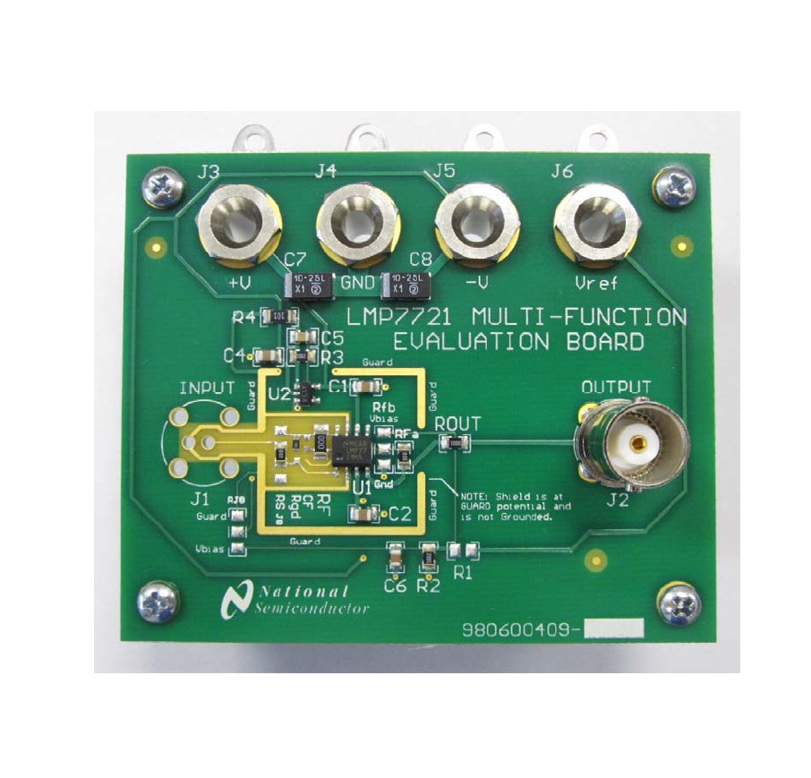



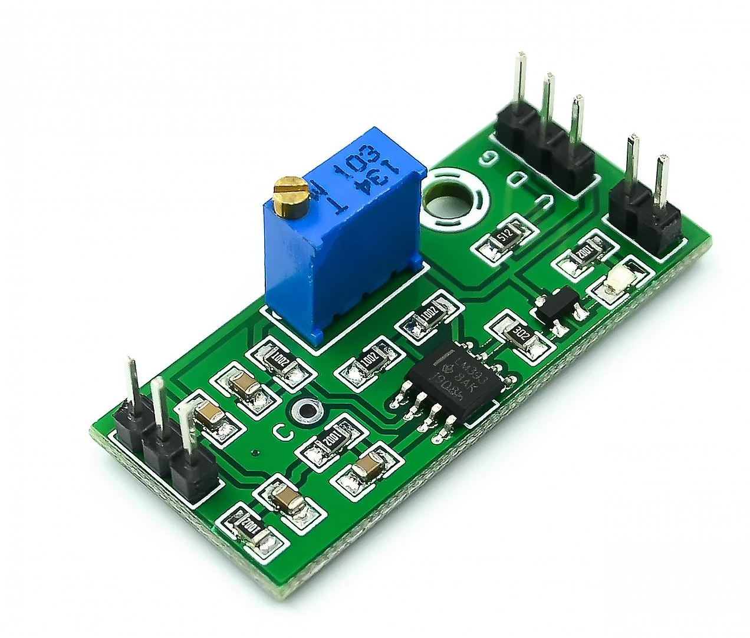
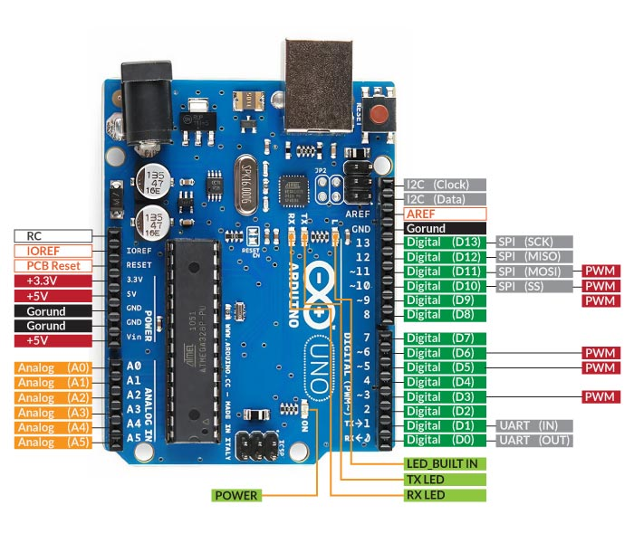



Key Component:
Photodetector
Generates photocurrent under UV illumination
LMP7721 Op-Amp
Converts current to voltage with ultra-low noise
Fig: 4 Photodetector Pixel
Fig: 4 LMP7721 OPAMP
LM393 Comparator
Converts analog signal to digital HIGH/LOW
Arduino Uno
Processes signals and reconstructs UV pattern
Fig: 4 LM393 Comparator
Fig: 4 Arduino Uno
8
Ref: Research gate, Texas Instrument, Components101

Slide 9
Working
Flow Chart Of Circuit Working
UV light falling on the Ga₂O₃ photodetector generates a very weak photocurrent proportional to UV intensity.
The LMP7721 op-amp converts this tiny current into an amplified voltage with low noise.
The LM393 comparator compares the voltage with a reference (~0.15 V) and outputs HIGH (1) for illuminated pixels and LOW (0) for non-illuminated pixels.
The Arduino reads these digital outputs from all detectors and reconstructs the illumination pattern to form a UV image.
UV Light
↓
Ga₂O₃ Photodetector
↓ (tiny photocurrent)
Transimpedance Amplifier (LMP7721)
↓ (current → amplified voltage)
Comparator (LM393)
↓ (voltage → digital 1/0)
Arduino Uno
↓
Pixel Mapping & Image Reconstruction
↓
Display / UV Image Output
9

Slide 10
Applications & Future Scope
Applications
Flame Detection: Industrial safety and combustion monitoring
Environmental Sensing: Ozone monitoring and pollution tracking
Aerospace & Defense: Missile plume detection and UV navigation
Scientific Research: Material science and spectroscopy
Future Improvement
Current design supports up to 4×4 arrays due to Arduino Uno pin limitations (12 digital, 6 analog).
Integration with Arduino Mega, FPGA boards, or multiplexing circuits for larger arrays and real-time imaging.
Incorporate column-parallel ADCs to digitize signals early and reduce analog routing noise
10

Slide 11
Limitation
The photodetector array size is limited due to the restricted number of input pins available on the Arduino Uno.
The circuit currently supports only binary detection (illuminated / not illuminated) — it cannot measure the intensity level of UV light.
Noise interference can occur in the absence of proper shielding or under strong ambient light conditions.
Imaging speed is slow for larger photodetector arrays because scanning is not yet optimized.
The setup has not been fully tested for outdoor long-distance UV source detection.

Slide 12
Conclusion
This project demonstrates the feasibility of Ga₂O₃-based solar-blind photodetector arrays for UV imaging applications.
Designed a complete readout circuit using LMP7721 op-amp, LM393 comparator, and Arduino Uno.
The circuit effectively converted weak UV photocurrents into digital pixel outputs for image reconstruction.
Ga₂O₃ is highly suitable for deep-UV detection due to its ultra-wide bandgap and stability.
The system proves that small photodetector arrays can perform real-time UV imaging, with potential for scaling to larger, high-resolution arrays.
12

Slide 13
THANK YOU

